Slide 1

Public engagement activity
Amaan Mujawar

Slide 2
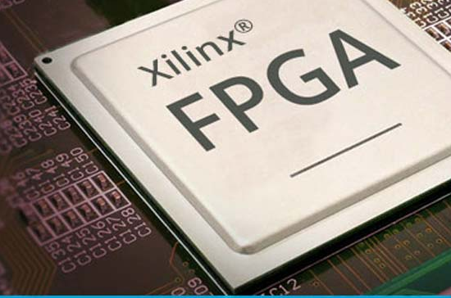

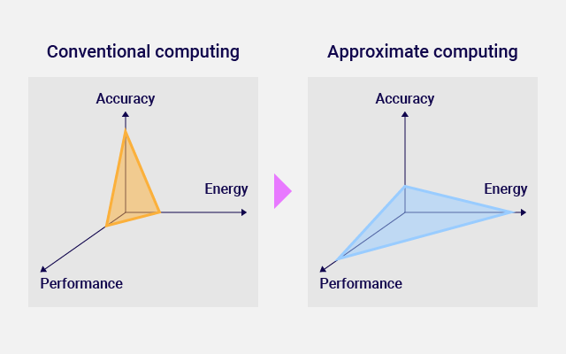
ABOUT the project
Implement an Arithmetic Unit Utilizing Approximate Computing into RISC-V SoC.
Supervisor: Mr. Neil Powell
2

Slide 3
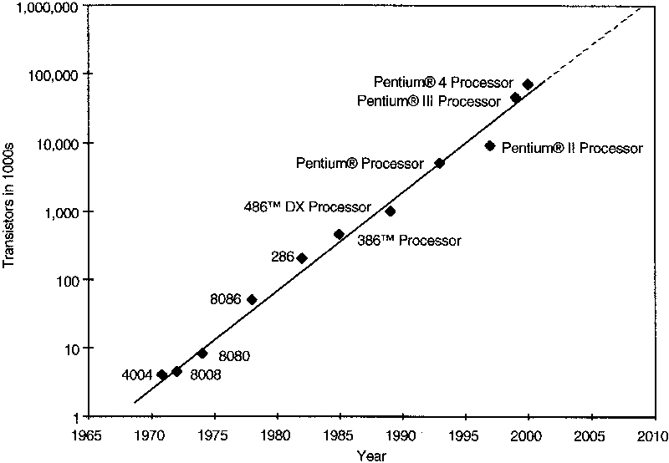
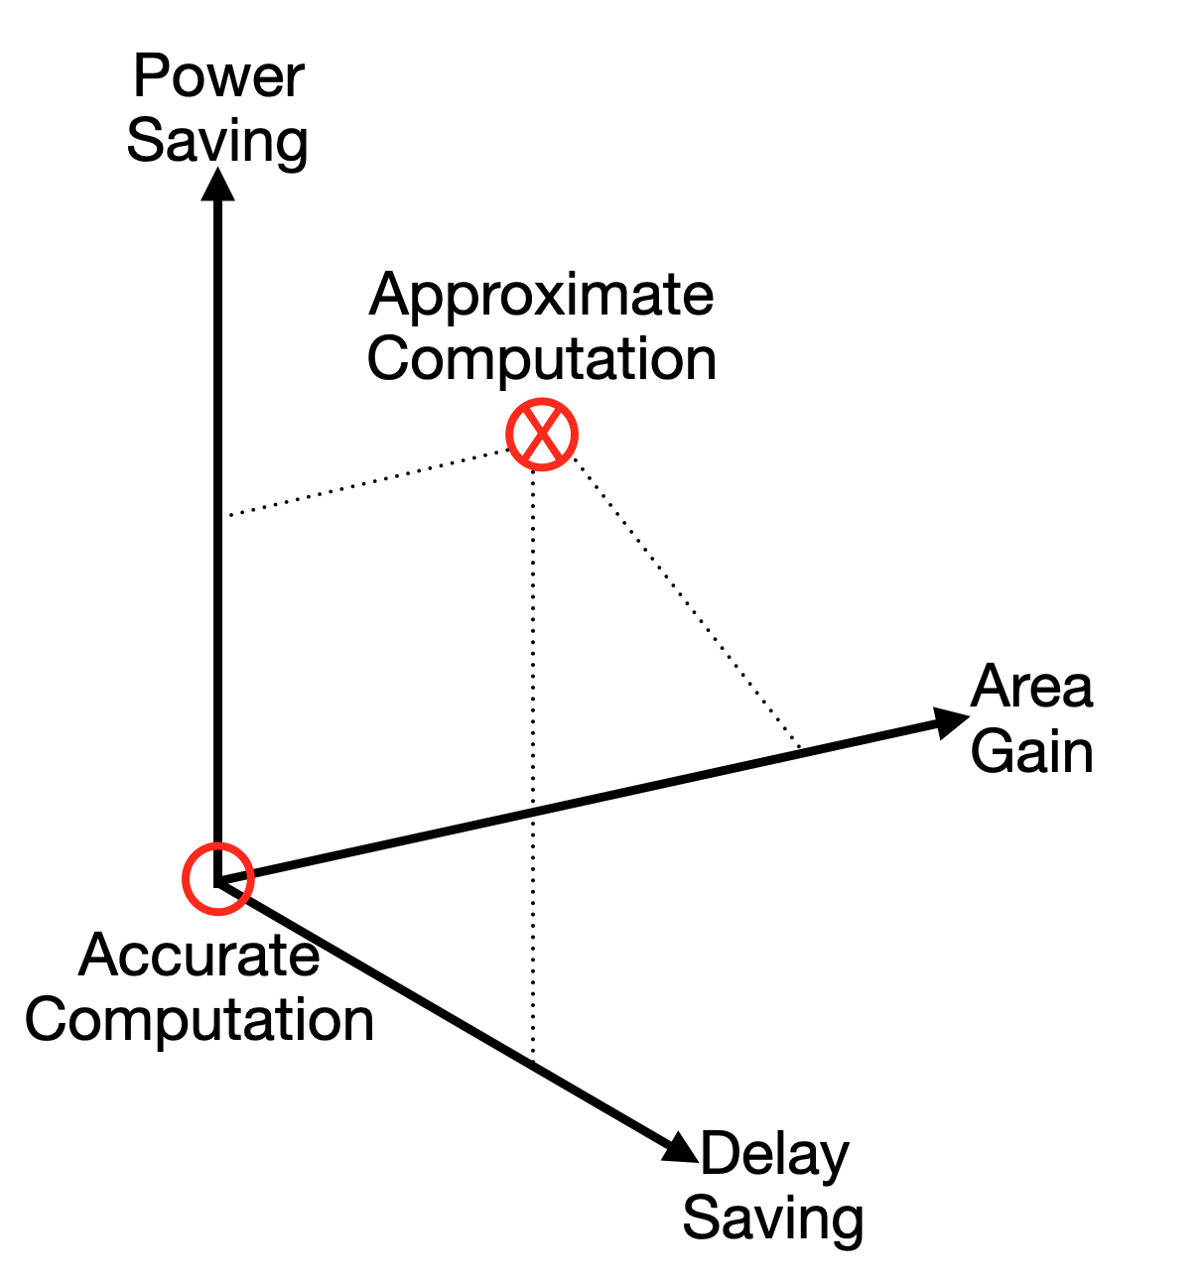
Background & motivation
Context
Growing demand for high-performance computing in machine learning, computer vision, and multimedia processing.
challenge
Traditional computing approaches are limited by the slowing of Moore's Law.
opportunity
Approximate computing allows controlled errors for faster and energy-efficient computation.
importance
Enables energy-efficient digital systems, suitable for error-tolerant applications like image processing.

Slide 4
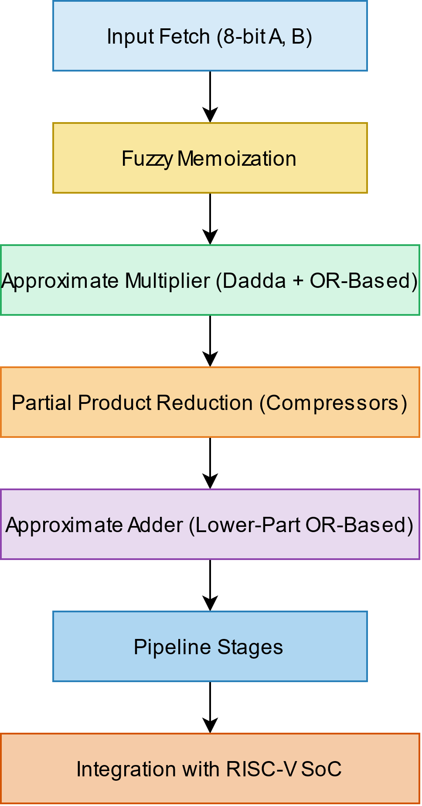
ARCHITECTURE
8-bit Approximate MAC Unit
Input Fetch Stage
8-bit operands (A and B) for multiplication
Inputs are passed into the fuzzy memoization block to check for stored approximate results
Fuzzy Memoization Block
Caches previous computations to avoid redundant calculations
Uses Hamming distance to find a similar previously stored input-output pair.
If a match is found, cached result is used instead of recalculating.
Approximate Multiplication Stage
Lower-Part OR-based Approximate Multiplier:
MSB (Most Significant Bits) handled with a Dadda Multiplier
LSB (Least Significant Bits) approximated using OR-based logic
Partial Product Reduction Stage
Uses compressor-based approximate multipliers
Approximate Addition Stage
Accumulation performed using Lower-Part OR-based Approximate Adders

Slide 5
Real-World Problem Addressed
Energy-Efficiency
Traditional computation
Reduced power consumption by allowing controlled errors
Lower energy requirements make it suitable for battery-powered devices
Precise arithmetic units consume more power and area
High accuracy but less energy-efficient
Approximate computing
Ideal tasks
Trades off accuracy for efficiency, reducing power and area
Suitable for error-tolerant applications like image processing and AI
Image processing (denoising, compression)
Machine learning
Signal processing in embedded systems
5

Slide 6
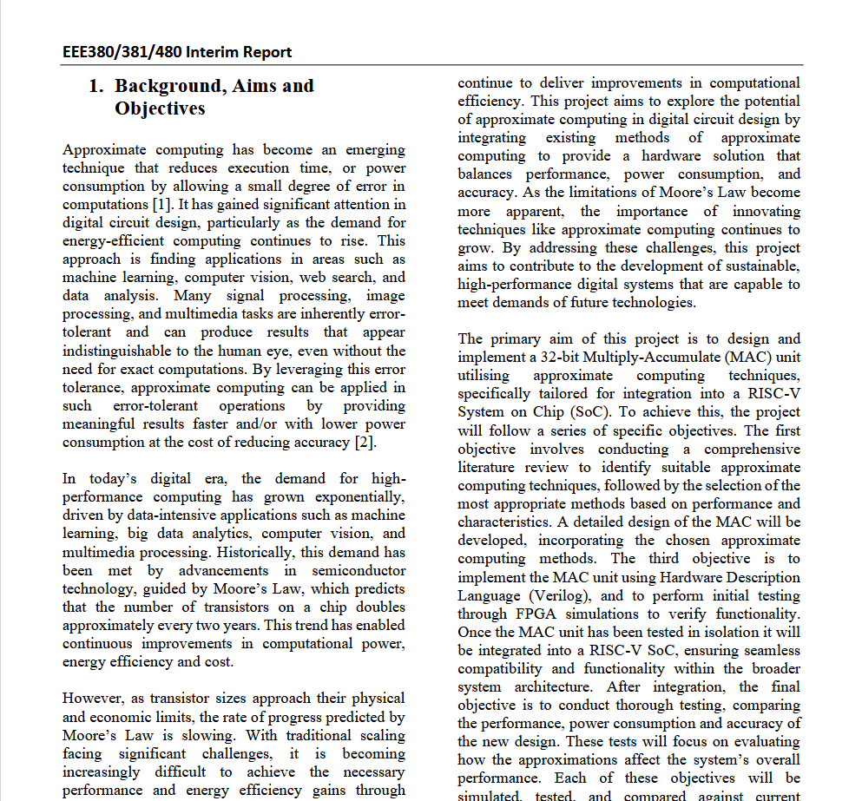
Aims & Objectives
AIMS
Design and implement an 8-bit Multiply-Accumulate (MAC) unit using approximate computing techniques
Implement an arithmetic unit utilizing approximate computing into a RISC-V SoC
Optimize the arithmetic unit for energy efficiency while maintaining acceptable computational accuracy.
OBJECTIVES
Design and simulate the MAC unit using Verilog on FPGA
Integrate the MAC unit into a RISC-V SoC
Evaluate, analyze and compare performance, power consumption, and accuracy against traditional designs
Validate the design using simulation tools
Assess the impact of approximation on computational accuracy
Evaluate the MAC unit’s performance in a fuzzy memoized FIR filter for image processing

Slide 7
Problem specification
Problem:
Balancing accuracy, power consumption, and speed in arithmetic units
Expected Results:
Enhanced computational efficiency with minimal accuracy loss
Reduced power consumption and chip area
Methodology:
Using Verilog for implementation and FPGA simulations
Implementing Approximate Adders and Approximate Multipliers based on existing designs

Slide 8
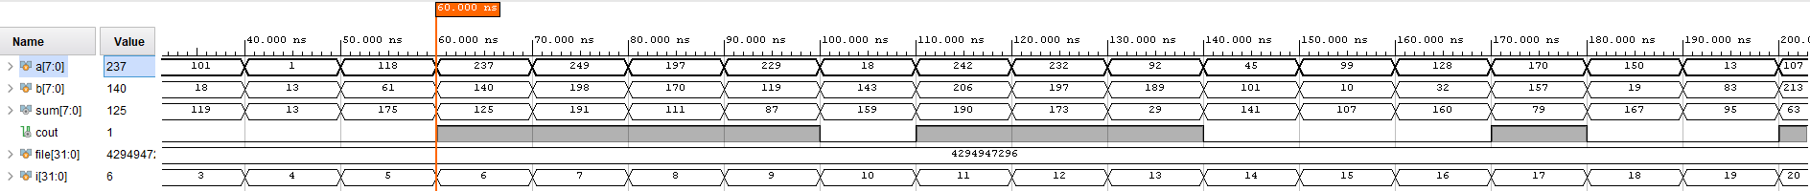
SIMULATION RESULTS - ADDER
8

Slide 9
SIMULATION RESULTS - Multiplier
9

Slide 10
Analysis and Significance
10

Slide 11
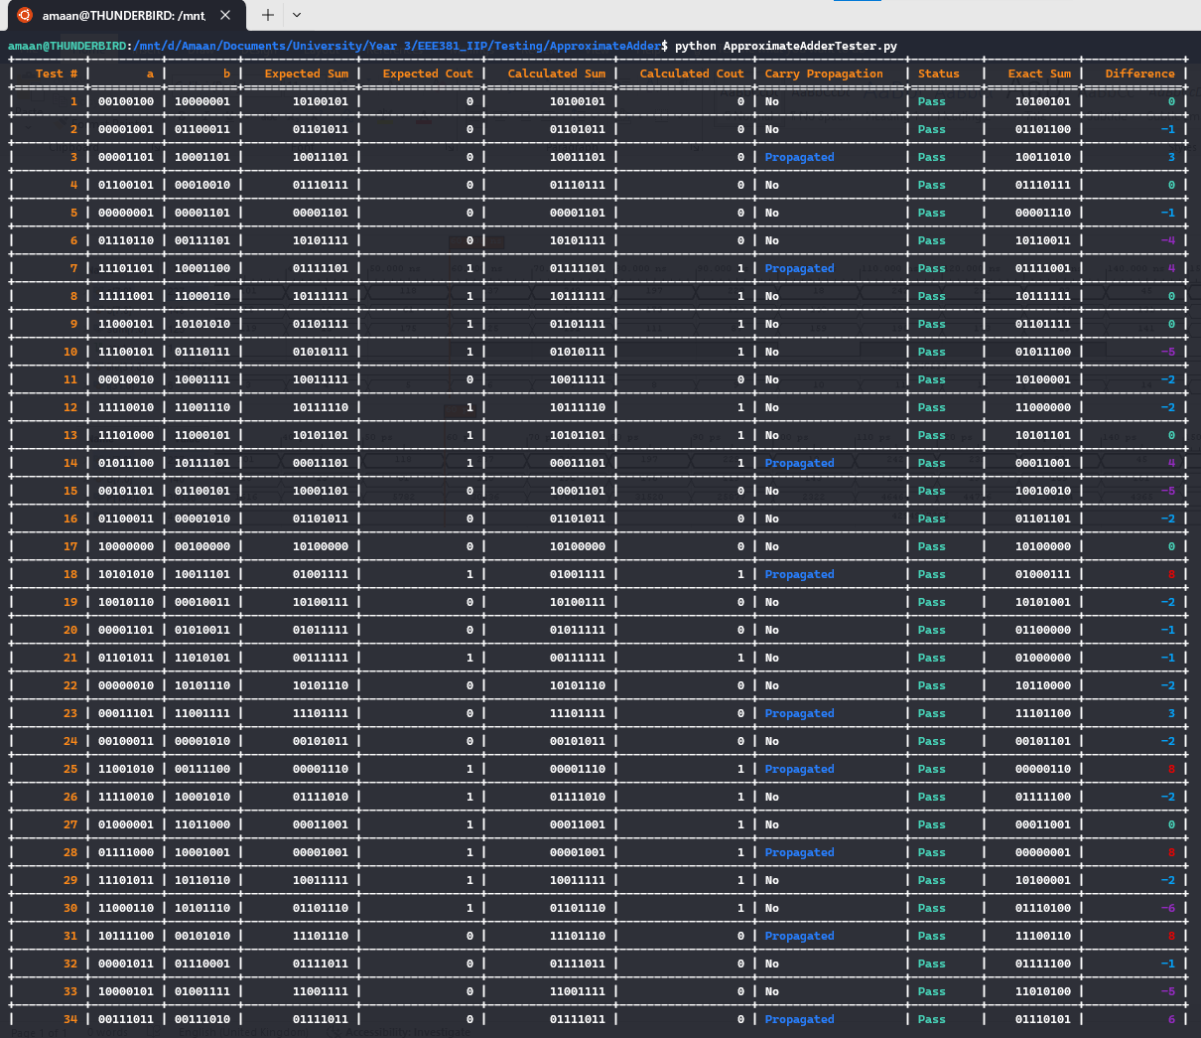
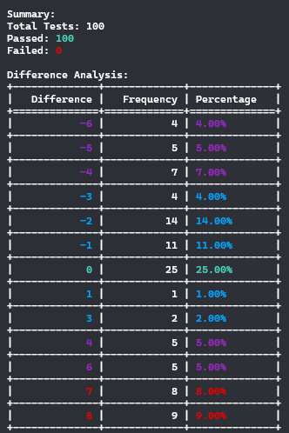
UNIT TESTING - Adder
11

Slide 12

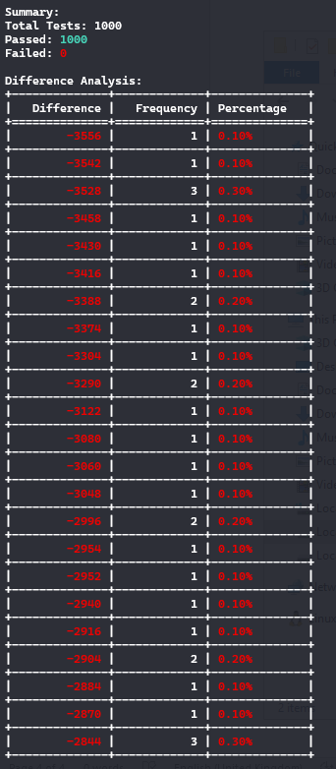
UNIT TESTING - Multiplier
12

Slide 13
Comparison: Aims and milestones
Achievements
Established a benchmark with a pipelined MAC unit
Conceptual and partial implementation of AAUD architecture
Implemented Approximate Adder and Approximate Multiplier
Unit testing completed and modules validated
Pending Tasks
Complete integration of approximate multipliers and adders
Explore Fuzzy memoization implementation
Conduct comprehensive testing for power, speed, and accuracy
Compare against other approximation units to evaluate performance

Slide 14
Future Work Plan
Next steps
Complete implementation of approximate arithmetic units
Integrate AAUD into RISC-V SoC and conduct full system testing
Evaluate performance against traditional MAC units
Long-term
Explore further optimizations with different approximation methods
Investigate potential applications in other error-tolerant domains, such as machine learning

Slide 15
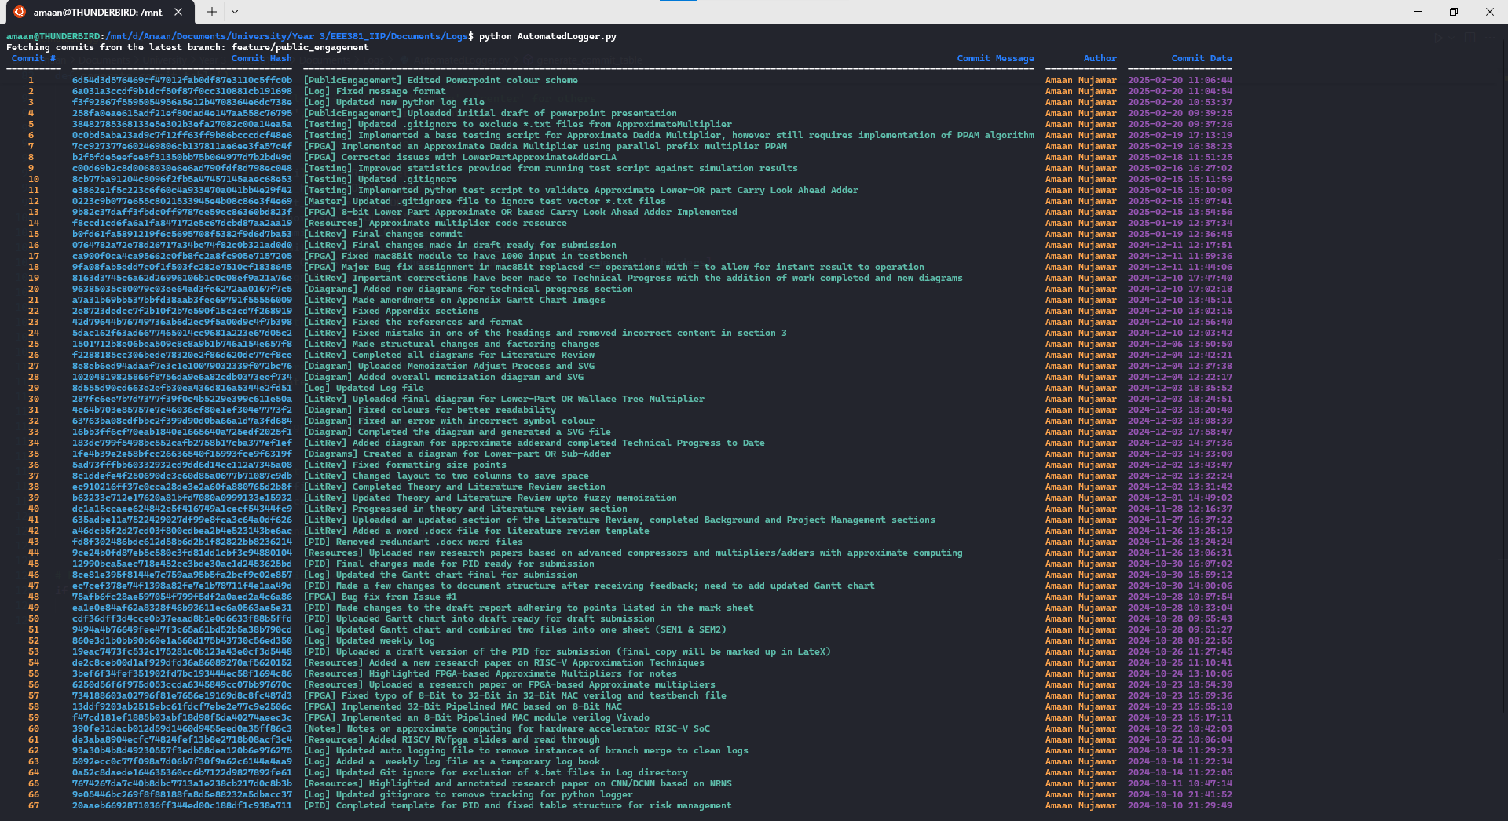

Slide 16
THANK YOU
Amaan Mujawar​
aurmujawar1@sheffield.ac.uk
The University of Sheffield – Electronics and Computer Engineering

